Slide 1
SC1015 MINI PROJECT
Class/Group
FCE3/Group 6
Members:
Faye Chan (U2322426D )
Jayashree Sivakumar (U2322599D)
Guan Xiaoxi (U2320285A)

Slide 2
Table of contents
01
02
03
04
Problem Formulation
Data Preparation and Cleaning
Exploratory Data Analysis
Our ML Model

Slide 3
01
Problem Formulation
Why this project?

Slide 4
75%
of Singaporeans get less than 7 hours of sleep

Slide 5



Physical Wellbeing
Mental Wellbeing
BETTER SLEEP = BETTER QUALITY OF LIFE

Slide 6
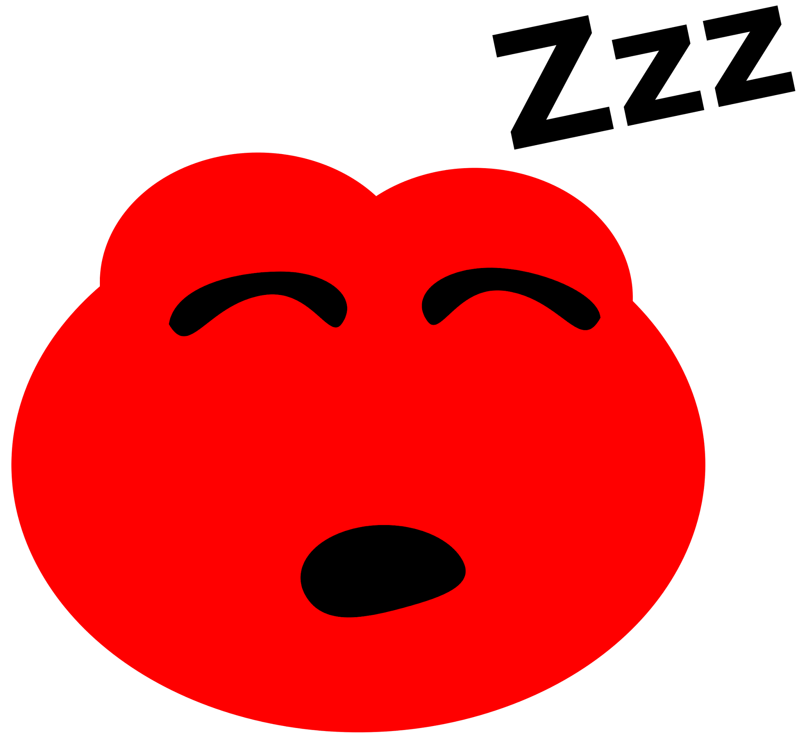
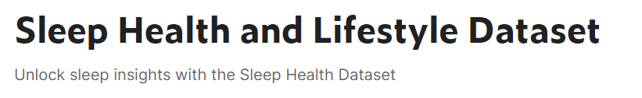
Our Dataset
Biology
Physics
Chemistry
→ wide range of variables related to sleep issues and daily habits
→ will allow us to possibly find predictors for sleep issues based on lifestyle choices and health conditions
Astronomy
Geology
Computer science
Unravel the mysteries of the cosmos, providing insights into our place in the universe
Identify valuable resources, and contribute to environmental conservation
Create technologies that drive the digital revolution, impacting other fields
Learn the fundamental laws that govern the behavior of matter and energy
Comprehend the diversity of life forms and the intricate mechanisms of cells or DNA
Study how elements behave, or develop materials with specific properties

Slide 7
Variables Used
VARIABLES
Comprehensive
Sleep Metrics
Lifestyle
Factors
Cardiovascular
Health
Sleep Disorder Analysis
E
F
B
Publication bias
G
H
D
Complex collaboration
Data analysis
Public perception
It includes details such as gender, age, occupation, sleep duration, quality of sleep, physical activity level, stress levels, BMI category, blood pressure, heart rate, daily steps, and the presence or absence of sleep disorders.
Key Features of the Dataset: Comprehensive Sleep Metrics: Explore sleep duration, quality, and factors influencing sleep patterns. Lifestyle Factors: Analyze physical activity levels, stress levels, and BMI categories. Cardiovascular Health: Examine blood pressure and heart rate measurements. Sleep Disorder Analysis: Identify the occurrence of sleep disorders such as Insomnia and Sleep Apnea.
Notes:
Comprehensive Sleep Metrics: Explore sleep duration, quality, and factors influencing sleep patterns.
Lifestyle Factors: Analyze physical activity levels, stress levels, and BMI categories.
Cardiovascular Health: Examine blood pressure and heart rate measurements.
Sleep Disorder Analysis: Identify the occurrence of sleep disorders such as Insomnia and Sleep Apnea
**Dataset Columns:**
- Person ID: An identifier for each individual.
- Gender: The gender of the person (Male/Female).
- Age: The age of the person in years.
- Occupation: The occupation or profession of the person.
- Sleep Duration (hours): The number of hours the person sleeps per day.
- Quality of Sleep (scale: 1-10): A subjective rating of the quality of sleep, ranging from 1 to 10.
- Physical Activity Level (minutes/day): The number of minutes the person engages in physical activity daily.
- Stress Level (scale: 1-10): A subjective rating of the stress level experienced by the person, ranging from 1 to 10.
- BMI Category: The BMI category of the person (e.g., Underweight, Normal, Overweight).
- Blood Pressure (systolic/diastolic): The blood pressure measurement of the person, indicated as systolic pressure over diastolic pressure.
- Heart Rate (bpm): The resting heart rate of the person in beats per minute.
- Daily Steps: The number of steps the person takes per day.
- Sleep Disorder: The presence or absence of a sleep disorder in the person (None, Insomnia, Sleep Apnea).

Slide 8
02
Data Preparation
and Cleaning
Notes:
Before we tackle our problem, the following steps are taken to clean and prepare the dataset.

Slide 9
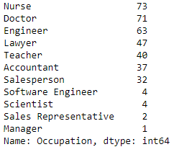
Data Preparation and Cleaning
Removing null values, duplicates and irrelevant columns like personID
2. Cleaning categorical variables like merging similar categories
Merging 'Sales Representative' with 'Salesperson' and Software Engineer' with 'Engineer'
3. Standardised naming convention
Rename 'Normal Weight' to 'Normal' for standardisation in BMI category column
4. Removing poorly represented categories
Removing ‘Scientist’ and ‘Manager’
Notes:
1. Removing null values, duplicates, and irrelevant columns like person ID
2. Cleaning categorical variables like merging similar categories
3. Standardized naming convention
4. Removing poorly represented categories

Slide 10
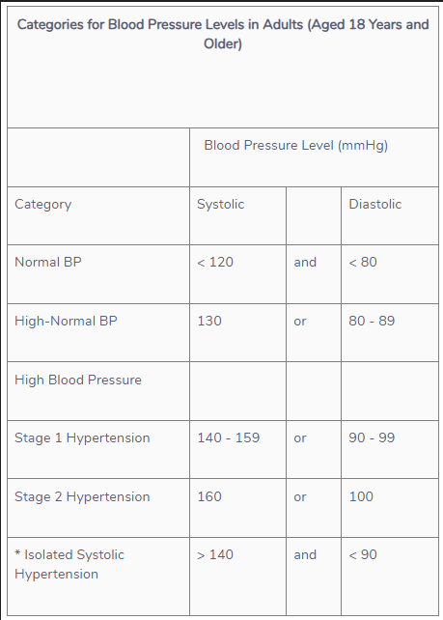
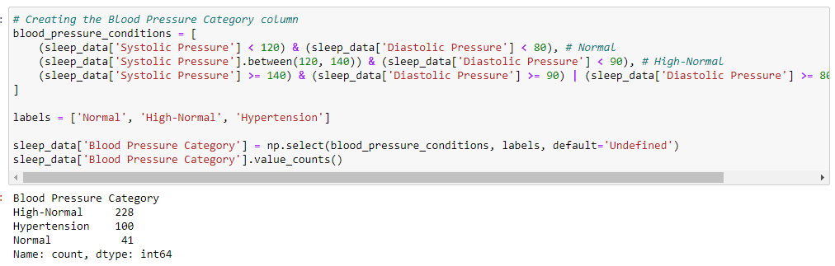
Data Preparation and Cleaning
5. Split blood pressure column into systolic and diastolic pressure
Used to calculate each individual’s blood pressure category
Systolic/Diastolic Format
Guidelines provided by HealthHub
Notes:
We also split the blood pressure column into systolic and diastolic pressure to calculate each individual’s blood pressure category based on this guideline.

Slide 11
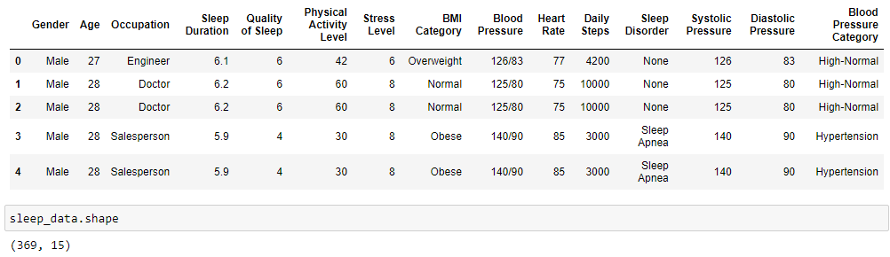
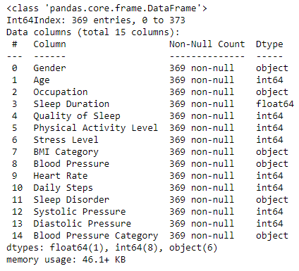
Final Cleaned Dataframe
Notes:
This is what the final cleaned dataframe looks like.

Slide 12
03
Exploratory Data Analysis
Setting up machine learning problem by using insights from EDA to identify top 3 predictors for ML model
Notes:
To set up the machine learning problem, we use the insights gained from Exploratory Data Analysis to identify the top 3 predictors for our ML model

Slide 13
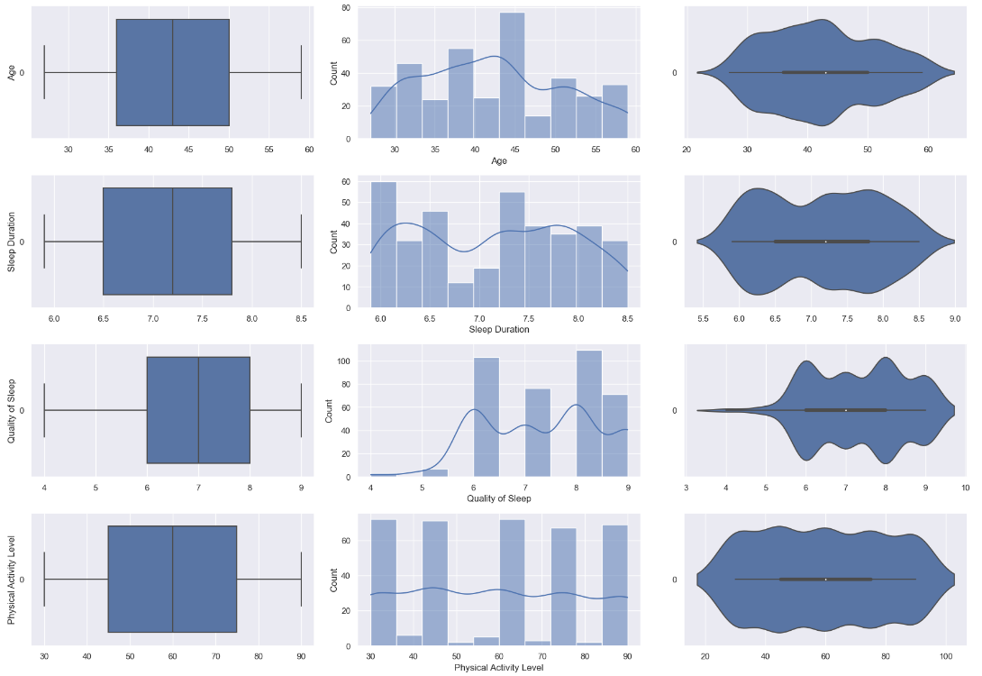
Univariate Analysis
Not much of a pattern to be observed
Negative Skew
Notes:
Univariate analysis showed not much of a pattern to be observed except for some negative skew here.

Slide 14
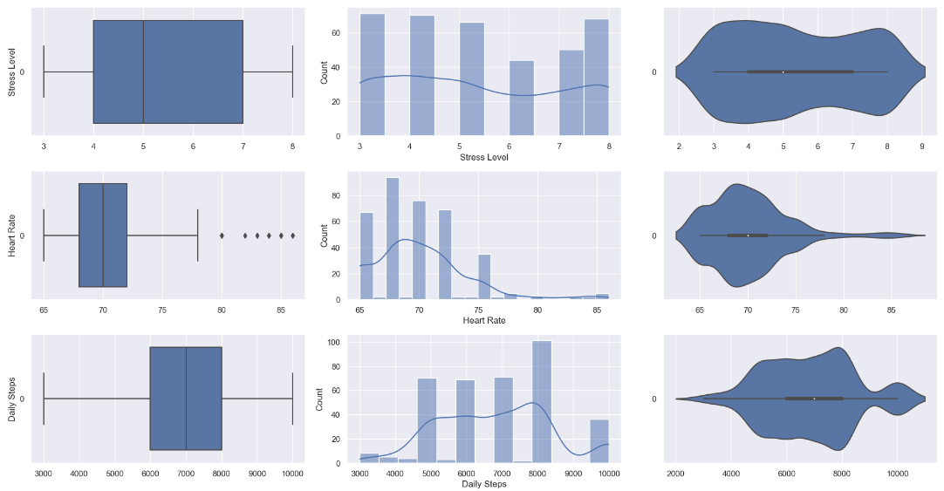
Univariate Analysis
Positive Skew
Outliers
Positive Skew
Notes:
And positive skew here.

Slide 15
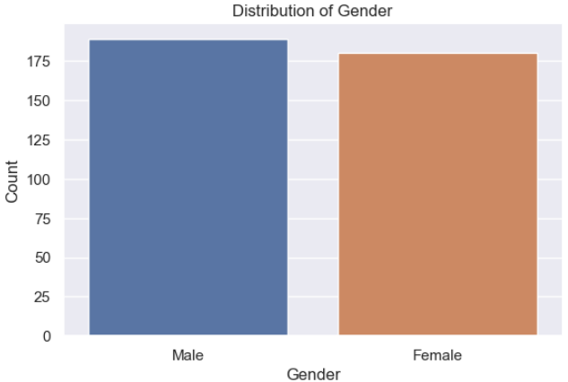
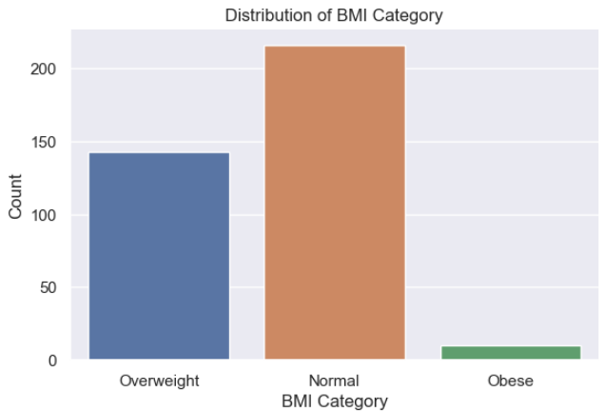
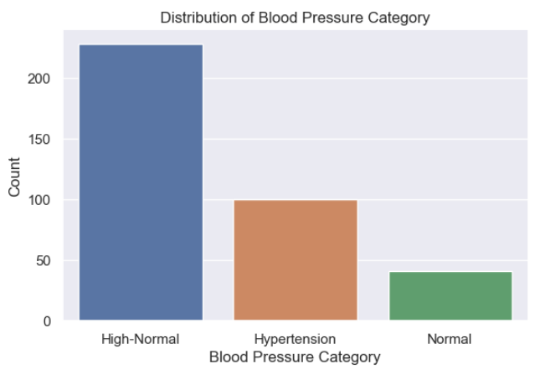
Univariate Analysis
Notes:
The distribution of gender, BMI category, blood pressure category are also quite self-explanatory.

Slide 16
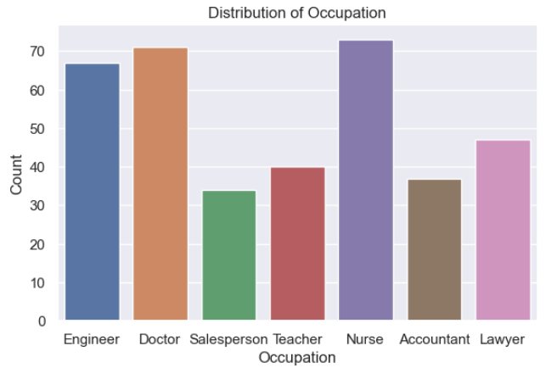
Univariate Analysis
Majority of nurses, doctors and engineers
Notes:
The distribution of occupation shows a majority of nurses, doctors, and engineers.

Slide 17
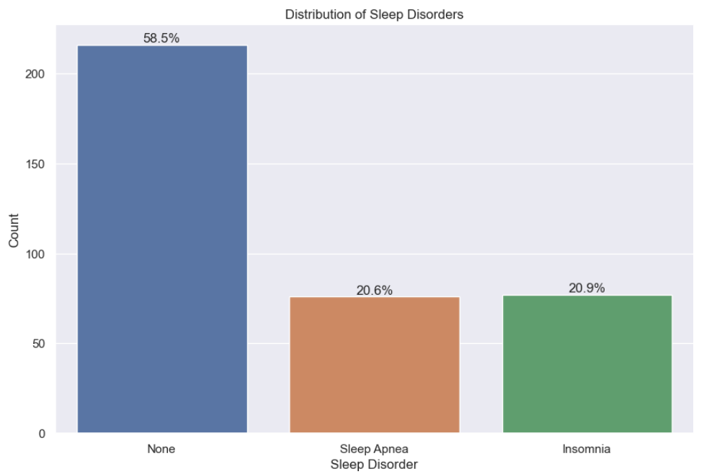
Univariate Analysis
Ratio of
58.5% to 41.5%
Notes:
The distribution of sleep disorders also shows the ratio of not having a sleep disorder to having one is 58.5% to 41.5% which makes analysing predictors related to sleep disorder a feasible problem statement.

Slide 18
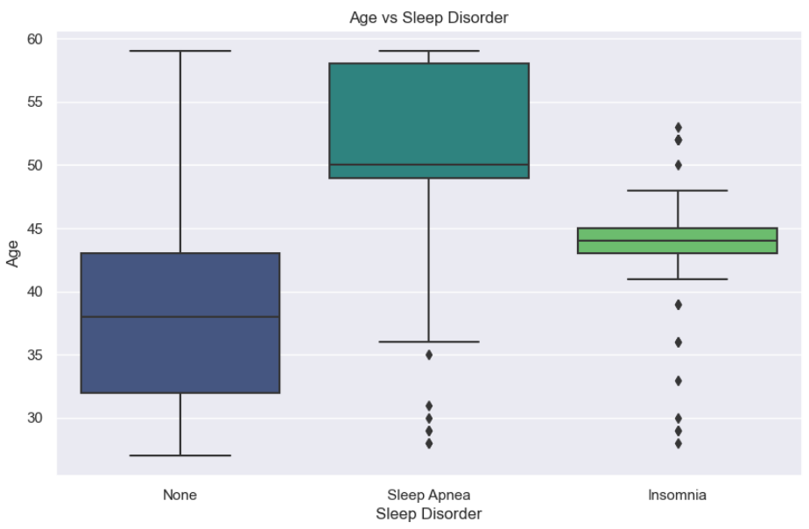
Bivariate Analysis - Age vs Sleep Disorder
Noticeable median range
Notes:
Looking at bivariate analysis we plot each variable against sleep disorder to identify potential predictors.
1. For Age vs sleep disorders, the noticeable difference in median range suggests that age may play a role in predicting the prevalence of sleep disorders.

Slide 19
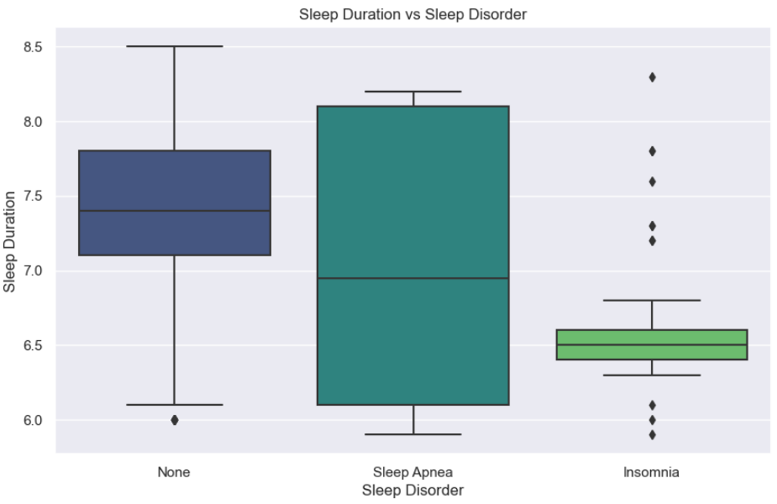
Bivariate Analysis - Sleep Duration v Sleep Disorder
Median of sleep apnea and insomnia are below recommended sleep duration for adults
Notes:
2. For sleep duration vs sleep disorders, the median of sleep apnea and insomnia are below 7 hours which can indicate a negative correlation.

Slide 20
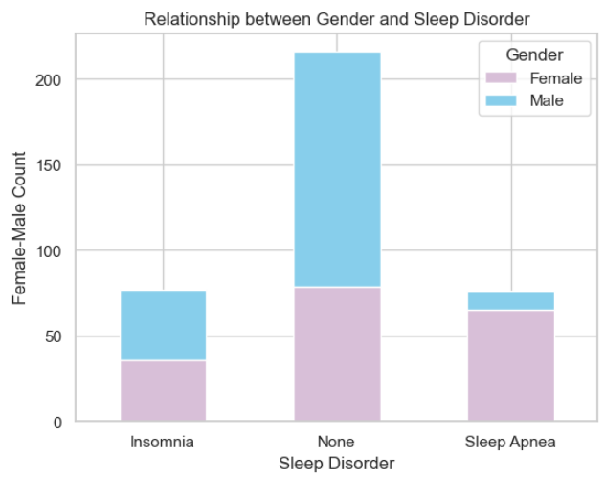
Bivariate Analysis - Gender vs Sleep Disorder
Females tend to suffer from sleep disorders compared to males
Men outnumber women
Women outnumber men
Notes:
3. For gender vs sleep disorders, females tend to suffer from sleep disorders compared to male. Women outnumber men when it comes to sleep apnea and men outnumber women when it comes to insomnia, indicating correlation.

Slide 21
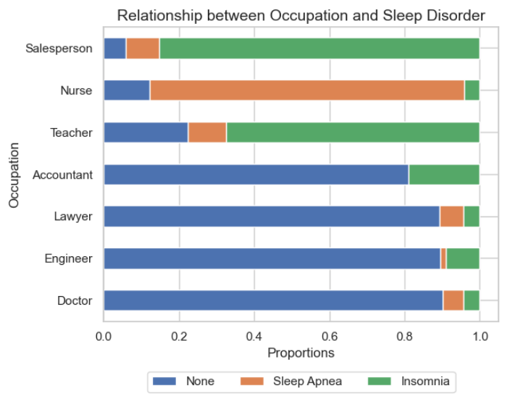
Bivariate Analysis - Occupation vs Sleep Disorder
A lot of insomnia
More nurses suffer sleep apnea
A lot of insomnia
Notes:
4. For occupation vs sleep disorder, significant portion of nurses suffer from sleep apnea compared to other occupations. Salespersons and teachers also exhibit a significance of insomnia.

Slide 22
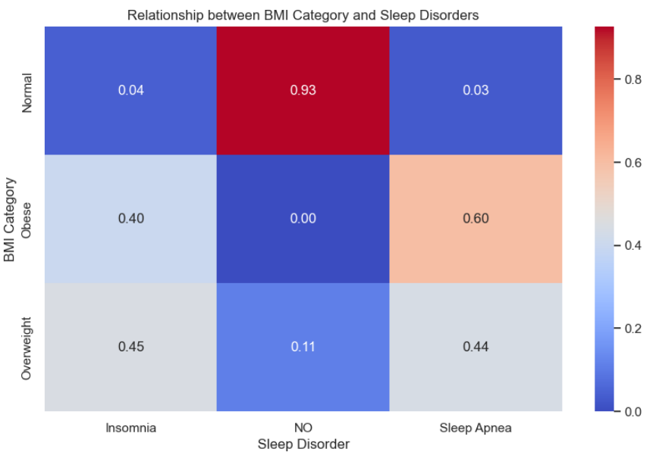
Bivariate Analysis - BMI vs Sleep Disorder
Normal BMI less likely to suffer from sleep disorders
Obese individuals have insomnia or sleep apnea
Overweight individuals have almost 50% chance of sleep disorders
Notes:
5. For BMI category vs sleep disorder, individuals with Normal BMI are less likely to suffer from sleep disorders.All obese individuals have either insomnia or sleep apnea. Individuals under the overweight category have almost a 50% chance to suffer from insomnia or sleep apnea.

Slide 23
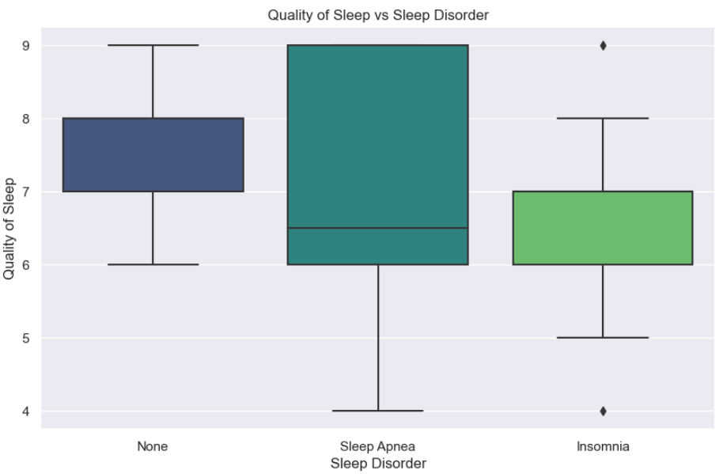
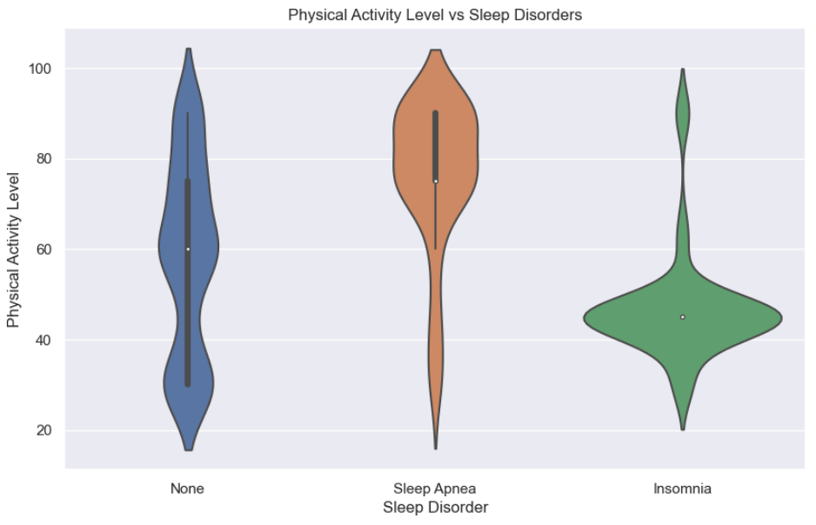
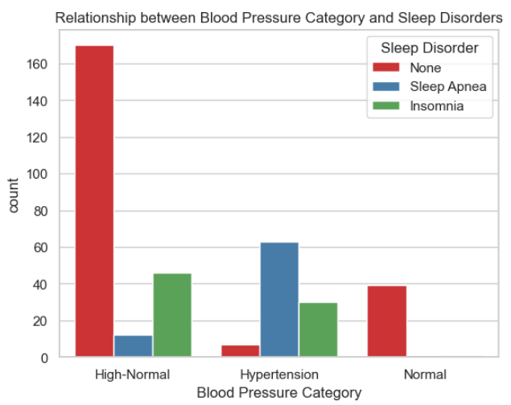
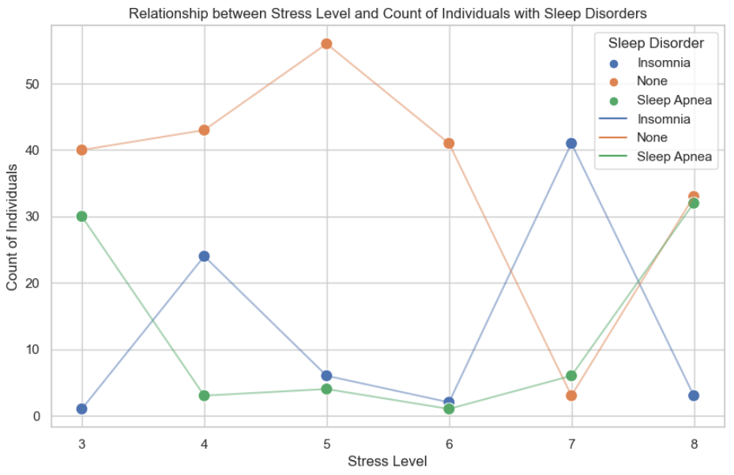
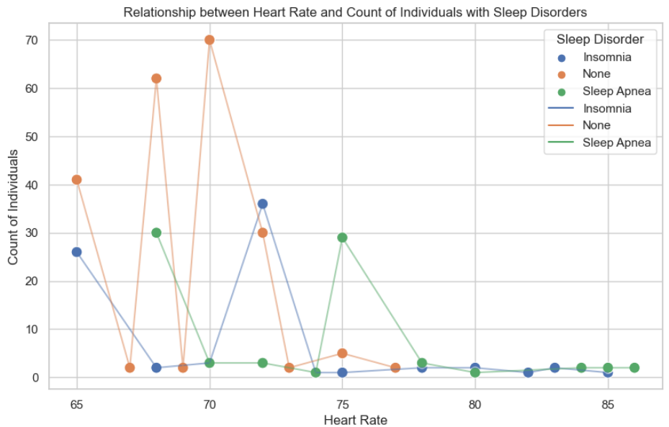
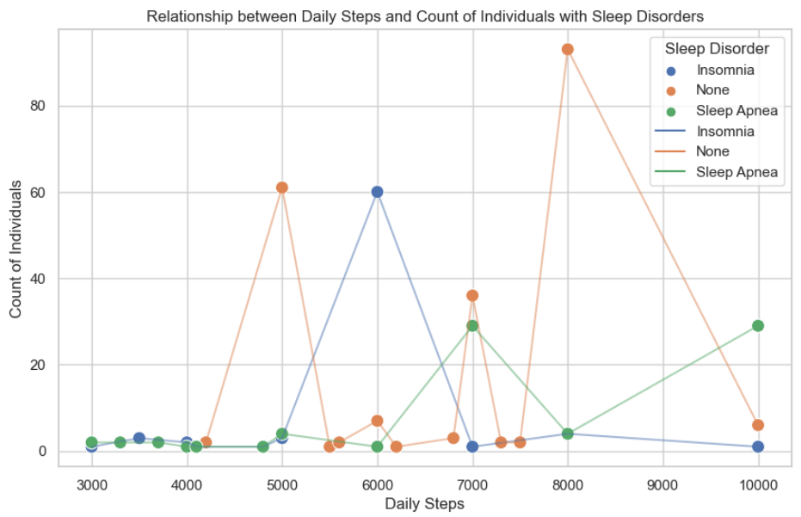
Bivariate Analysis
No correlation
Missing median line
Missing IQR box
No correlation
No correlation
No correlation
Notes:
6. Quality of sleep, physical level, stress level, heart rate, number of daily steps and blood pressure category are determined to be bad predictors as some of them are either missing median lines, IQR boxes, showing no correlation or contain anomalies.

Slide 24
Finding Top 3 Predictors
From EDA we identify 5 predictors:
Age
Sleep duration
Gender
Occupation
BMI category
Label encoder module from sklearn
Calculate correlation matrix
Plotly for visualisation
Choose top 3 predictors
Notes:
To narrow down these 5 predictors to 3, we calculate and plot the correlation matrix heatmap using label encoder module from sklearn to encode the variables and plotly to filter.

Slide 25
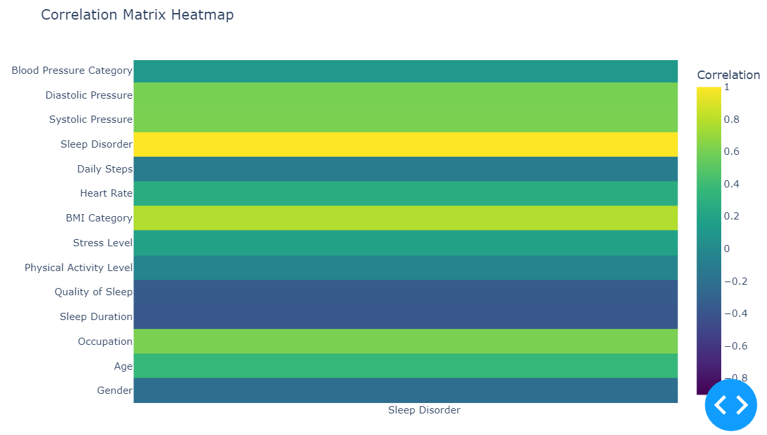
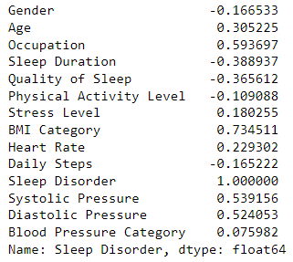
Correlation matrix
Systolic and diastolic pressure are excluded from the analysis as it is specifically used to calculate blood pressure category
Notes:
Note that systolic and diastolic pressure are excluded from our analysis as the values are only used to calculate blood pressure category. We find that BMI category, occupation and sleep duration are our top 3 predictors. Despite its negative correlation, sleep duration is included because it can still impact predictions in the opposite direction.

Slide 26
04
Machine Learning Models
Which is the best predictive model?

Slide 27
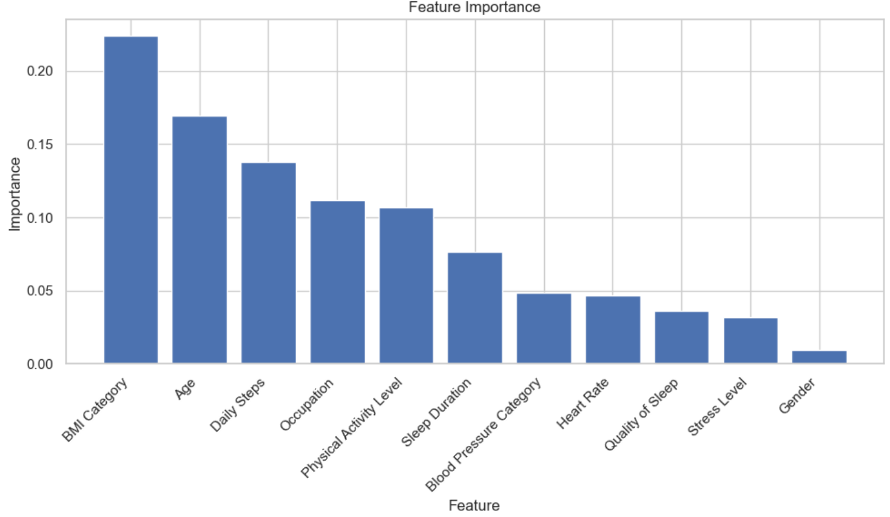
Feature Importance

Slide 28
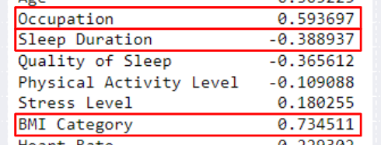
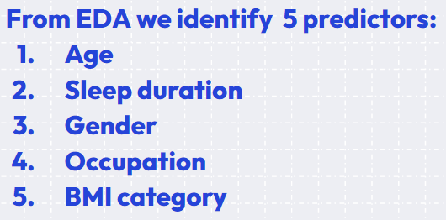
Choose predictors for our models
Model 1: Occupation, Sleep Duration, BMI Category
Model 2: BMI Category, Age, Daily Steps
Model 3: Occupation, Sleep Duration, Daily Steps
Model 4: BMI Category, Age, Gender

Slide 29
Machine Learning Process
Training and testing using RandomForest Method
GridSearch to find best parameters for each model
Build post-tuning model
Training and testing using RandomForest Method

Slide 30
Result
 | Train data accuracy | Test data accuracy | Post-tuning train accuracy | Post-tuning test accuracy | Cross validation score
Model 1 | 0.9147 | 0.9009 | 0.9147 | 0.9099 | 0.8954
Model 2 | 0.9070 | 0.8919 | 0.8837 | 0.8829 | 0.8876
Model 3 | 0.8876 | 0.8829 | 0.9302 | 0.9189 | 0.8991
Model 4 | 0.8798 | 0.8649 | 0.8760 | 0.8649 | 0.8761

Slide 31
05
Conclusion
What is the outcome and data-driven insights?

Slide 32

Best Model
===MODEL THREE===
HIGHEST post-tuning test accuracy : 0.9189
HIGHEST cross validation score : 0.8991
Model 3 successful in generalising to unseen data by testing it on multiple subsets
Model 3 has exceptional performance after hyperparameter optimisation
RIGOROUS VALIDATION CAREFUL TUNING RELIABLE PREDICTIONS IN PRACTICAL USES
Notes:
Cross-validation scores indicate how well a machine learning model generalizes to unseen data by testing it on multiple subsets, while post-tuning test accuracy reflects the model's performance after hyperparameter optimization. If both scores are high, it suggests that the model is robust, has learned the patterns from the data effectively rather than memorizing it, and is expected to perform well on new, similar data. This combination of rigorous validation and careful tuning is often indicative of a model that will make reliable predictions in practical applications.

Slide 33

Recommendations based on our model:
PREDICTORS
DAILY STEPS
SLEEP DURATION
OCCUPATION
E
F
B
Publication bias
G
H
D
Complex collaboration
Data analysis
Public perception
It includes details such as gender, age, occupation, sleep duration, quality of sleep, physical activity level, stress levels, BMI category, blood pressure, heart rate, daily steps, and the presence or absence of sleep disorders.
Key Features of the Dataset: Comprehensive Sleep Metrics: Explore sleep duration, quality, and factors influencing sleep patterns. Lifestyle Factors: Analyze physical activity levels, stress levels, and BMI categories. Cardiovascular Health: Examine blood pressure and heart rate measurements. Sleep Disorder Analysis: Identify the occurrence of sleep disorders such as Insomnia and Sleep Apnea.
Notes:
So these are the three indicators used in model 3 which proved to be the best model in predicting sleep disorders specifically sleep duration, daily steps and occupation. As occupation is not super controllable,

Slide 34

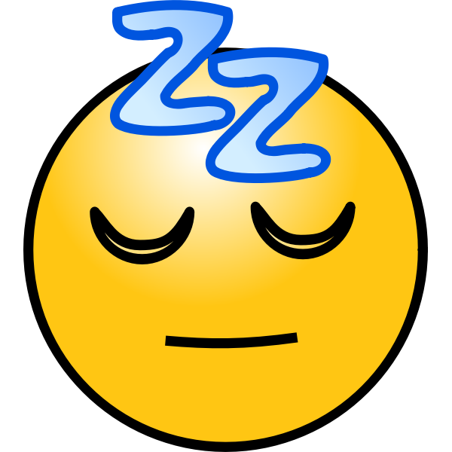
Recommendations based on our model:
1
Engage in daily exercise
30 minutes of exercise as recommended by HPB
OR 10,000 steps everyday
2
Have sufficient sleep and consistent sleep cycle
Have at least 6-7 hours of sleep daily
Avoid using devices right before sleeping for better sleep quality
E
F
B
Publication bias
G
H
D
Complex collaboration
Data analysis
Public perception
It includes details such as gender, age, occupation, sleep duration, quality of sleep, physical activity level, stress levels, BMI category, blood pressure, heart rate, daily steps, and the presence or absence of sleep disorders.
Key Features of the Dataset: Comprehensive Sleep Metrics: Explore sleep duration, quality, and factors influencing sleep patterns. Lifestyle Factors: Analyze physical activity levels, stress levels, and BMI categories. Cardiovascular Health: Examine blood pressure and heart rate measurements. Sleep Disorder Analysis: Identify the occurrence of sleep disorders such as Insomnia and Sleep Apnea.
Notes:
So these are the three indicators used in model 3 which proved to be the best model in predicting sleep disorders specifically sleep duration, daily steps and occupation. As occupation is not super controllable,

Slide 35
Thank You!

